Slide 1
Dijkstra’s Algorithm Animations

Slide 2
Shortest Path Problem
Definition: Find the shortest path between two vertices (source and destination) such that the sum of the weights of it’s edges are minimised.
Perhaps one of the most fundamental problems in Mathematics and Computer Science
Huge implications on routing and traffic problems, e.g. vehicular, telecommunications.
If you’ve used Google Maps, you’ve asked to solve a form of shortest path problem!

Slide 3
Blue Peter Example
11
1
2
9
12
3
0
4
5
5
2
1
6
3
4
8
What is the shortest path between 0 and 5?

Slide 4
Blue Peter Example
11
1
2
9
12
3
0
4
5
5
2
1
6
3
4
8
Shortest path between 0 and 5 is 0-3-1-4-5 of length 15

Slide 5
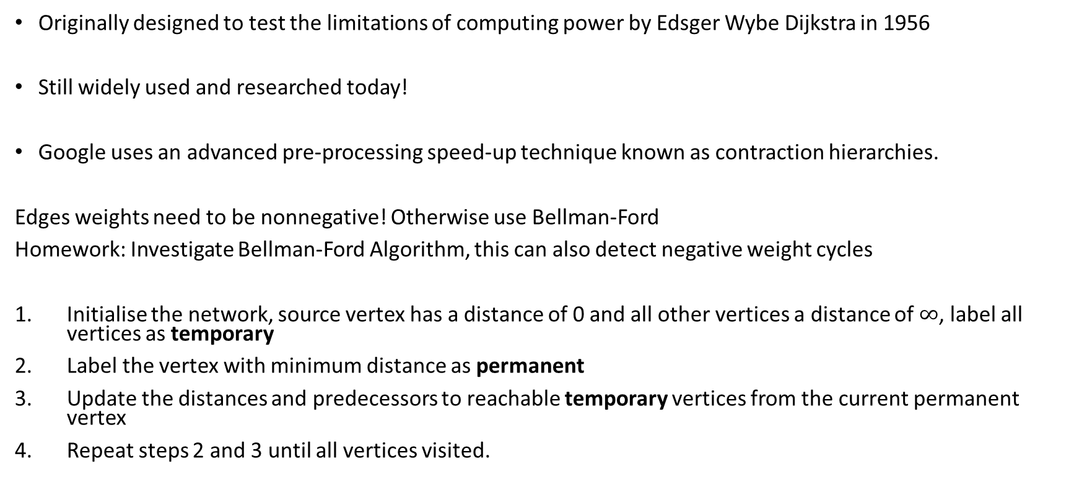
Dijkstra’s Algorithm
Originally designed to test the limitations of computing power by Edsger Wybe Dijkstra in 1956
Still widely used and researched today!
Google uses an advanced pre-processing speed-up technique known as contraction hierarchies.
Edges weights need to be nonnegative! Otherwise use Bellman-Ford
Homework: Investigate Bellman-Ford Algorithm, this can also detect negative weight cycles
Initialise the network, source vertex has a distance of 0 and all other vertices a distance of $∞$, label all vertices as temporary
Label the vertex with minimum distance as permanent
Update the distances and predecessors to reachable temporary vertices from the current permanent vertex
Repeat steps 2 and 3 until all vertices visited.

Slide 6

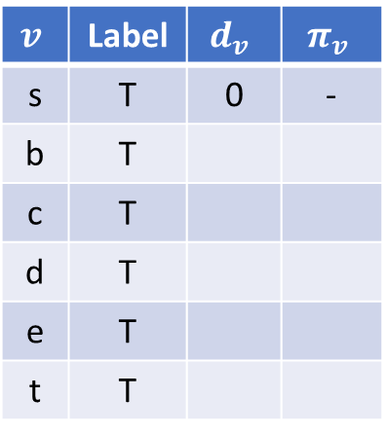

Set Up
$$v$$
Permanent
$$v$$
Temporary
-
-
∞
∞
11
$$v$$ | Label | $$d_{v}$$ | $$π_{v}$$
s | T | 0 | -
b | T
c | T
d | T
e | T
t | T
b
c
9
12
-
3
-
0
s
4
5
t
∞
2
1
6
d
e
8
∞
∞
-
-
Initialise the network, source vertex has a distance of 0 and all other vertices a distance of $∞$

Slide 7




Improving Cost Labels
Imagine you know some path $p$ from node $s$ to node $j$ that has a distance $d_{j}$
If this is not TRUE then there exists some path that improves $d_{j}$
E.g. The path to $d_{i}$ + the edge $(i,j)$
$$d_{i}$$
i
x
y
$$c_{ij}$$
z
s
j
x + y ≥ z
$$d_{j}$$

Slide 8
Example 1

Slide 9
Dijkstra Example
$$v$$
Permanent
$$v$$
Temporary
-
-
∞
∞
11
$$v$$ | Label | $$d_{v}$$ | $$π_{v}$$
s | T | 0 | -
b | T
c | T
d | T
e | T
t | T
b
c
9
12
-
3
-
0
s
4
5
t
∞
2
1
6
d
e
8
∞
∞
-
-
Initialise the network, source vertex has a distance of 0 and all other vertices a distance of $∞$

Slide 10
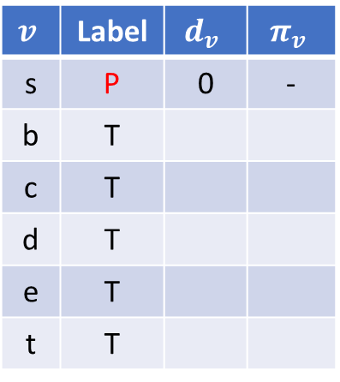
Example
$$v$$
Permanent
$$v$$
Temporary
-
-
∞
∞
11
$$v$$ | Label | $$d_{v}$$ | $$π_{v}$$
s | P | 0 | -
b | T
c | T
d | T
e | T
t | T
b
c
9
12
-
3
-
0
s
4
5
t
∞
2
1
6
d
e
8
∞
∞
-
-
Label temporary vertex with minimum distance as permanent

Slide 11
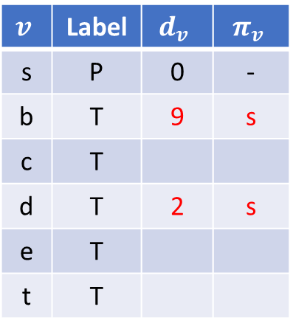
Example
$$v$$
Permanent
$$v$$
Temporary
s
-
9
∞
11
$$v$$ | Label | $$d_{v}$$ | $$π_{v}$$
s | P | 0 | -
b | T | 9 | s
c | T
d | T | 2 | s
e | T
t | T
0+9=9
b
c
9
12
-
3
-
0
s
4
5
t
∞
2
1
6
0+2=2
d
e
8
2
∞
s
-
Update distances to reachable vertices which are labelled temporary

Slide 12
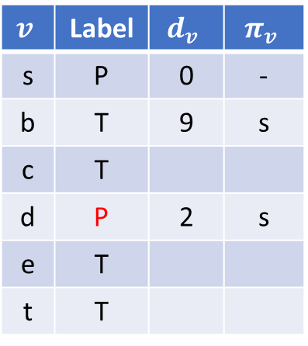
Example
$$v$$
Permanent
$$v$$
Temporary
s
-
9
∞
11
$$v$$ | Label | $$d_{v}$$ | $$π_{v}$$
s | P | 0 | -
b | T | 9 | s
c | T
d | P | 2 | s
e | T
t | T
b
c
9
12
-
3
-
0
s
4
5
t
∞
2
1
6
d
e
8
2
∞
s
-
Label temporary vertex with minimum distance as permanent

Slide 13
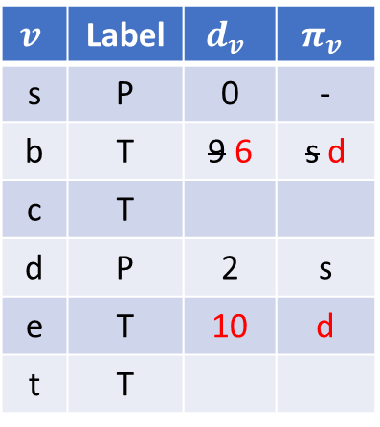
Example
$$v$$
Permanent
$$v$$
Temporary
d
-
6
∞
11
$$v$$ | Label | $$d_{v}$$ | $$π_{v}$$
s | P | 0 | -
b | T | 9 6 | s d
c | T
d | P | 2 | s
e | T | 10 | d
t | T
b
c
9
12
-
3
-
0
s
4
2+4=6
5
t
∞
2
1
6
d
e
8
2
10
2+8=10
s
d
Update distances to reachable vertices which are labelled temporary

Slide 14
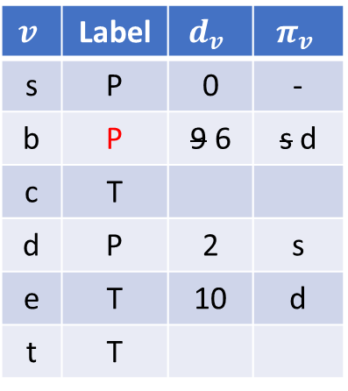
Example
$$v$$
Permanent
$$v$$
Temporary
d
-
6
∞
11
$$v$$ | Label | $$d_{v}$$ | $$π_{v}$$
s | P | 0 | -
b | P | 9 6 | s d
c | T
d | P | 2 | s
e | T | 10 | d
t | T
b
c
9
12
-
3
-
0
s
4
5
t
∞
2
1
6
d
e
8
2
10
s
d
Label temporary vertex with minimum distance as permanent

Slide 15
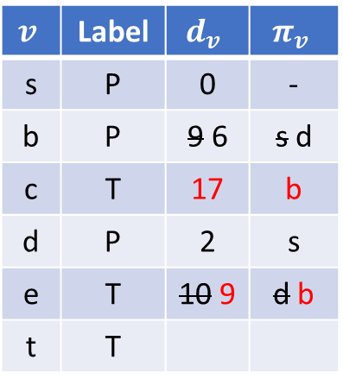
Example
$$v$$
Permanent
$$v$$
Temporary
d
6+11=17
b
6
17
11
$$v$$ | Label | $$d_{v}$$ | $$π_{v}$$
s | P | 0 | -
b | P | 9 6 | s d
c | T | 17 | b
d | P | 2 | s
e | T | 10 9 | d b
t | T
b
c
9
12
-
3
-
4
6+3=9
5
0
s
t
∞
2
1
6
d
e
8
2
9
s
b
Update distances to reachable vertices which are labelled temporary

Slide 16
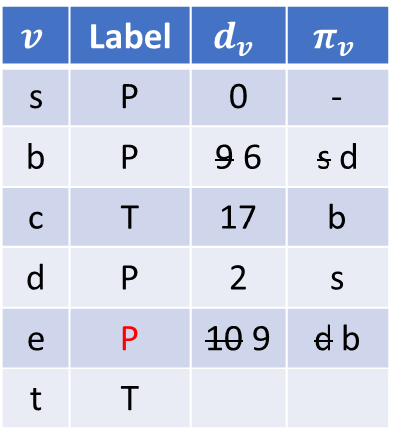
Example
$$v$$
Permanent
$$v$$
Temporary
d
b
6
17
11
$$v$$ | Label | $$d_{v}$$ | $$π_{v}$$
s | P | 0 | -
b | P | 9 6 | s d
c | T | 17 | b
d | P | 2 | s
e | P | 10 9 | d b
t | T
b
c
9
12
-
3
-
0
s
4
5
t
∞
2
1
6
d
e
8
2
9
s
b
Label temporary vertex with minimum distance as permanent

Slide 17
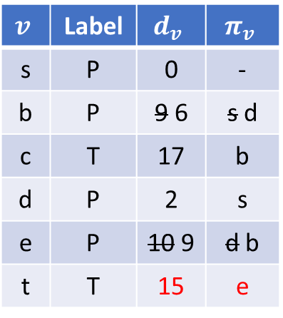
Example
$$v$$
Permanent
$$v$$
Temporary
d
b
6
17
11
$$v$$ | Label | $$d_{v}$$ | $$π_{v}$$
s | P | 0 | -
b | P | 9 6 | s d
c | T | 17 | b
d | P | 2 | s
e | P | 10 9 | d b
t | T | 15 | e
b
c
9
12
-
3
e
0
s
4
5
t
15
2
1
6
d
e
9+6=15
8
2
9
s
b
Update distances to reachable vertices which are labelled temporary

Slide 18
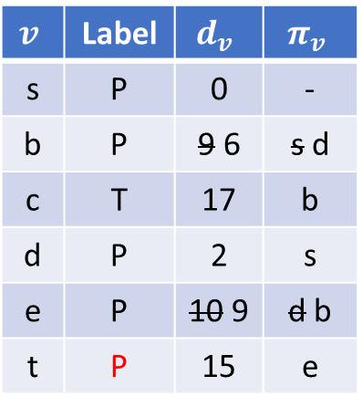
Example
$$v$$
Permanent
$$v$$
Temporary
d
b
6
17
11
$$v$$ | Label | $$d_{v}$$ | $$π_{v}$$
s | P | 0 | -
b | P | 9 6 | s d
c | T | 17 | b
d | P | 2 | s
e | P | 10 9 | d b
t | P | 15 | e
b
c
9
12
-
3
e
0
s
4
5
t
15
2
1
6
d
e
8
2
9
s
b
Label temporary vertex with minimum distance as permanent

Slide 19
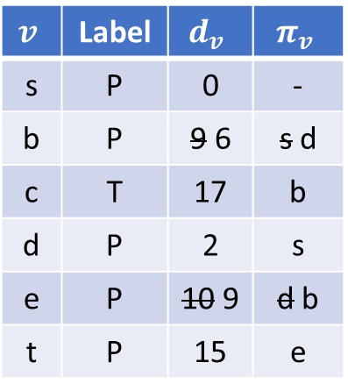
Example
$$v$$
Permanent
$$v$$
Temporary
d
b
6
17
11
$$v$$ | Label | $$d_{v}$$ | $$π_{v}$$
s | P | 0 | -
b | P | 9 6 | s d
c | T | 17 | b
d | P | 2 | s
e | P | 10 9 | d b
t | P | 15 | e
b
c
9
12
-
3
e
0
s
4
5
t
15
2
1
6
d
e
8
2
9
s
b
Update distances to reachable vertices which are labelled temporary. No changes

Slide 20
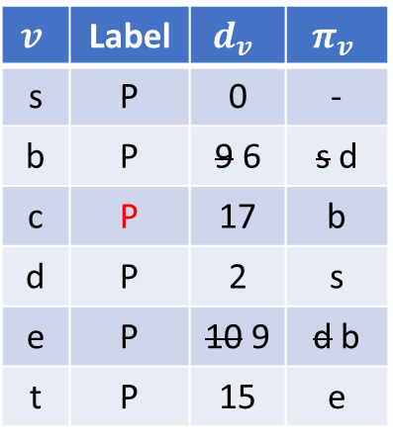
Example
$$v$$
Permanent
$$v$$
Temporary
d
b
6
17
11
$$v$$ | Label | $$d_{v}$$ | $$π_{v}$$
s | P | 0 | -
b | P | 9 6 | s d
c | P | 17 | b
d | P | 2 | s
e | P | 10 9 | d b
t | P | 15 | e
b
c
9
12
-
3
e
0
s
4
5
t
15
2
1
6
d
e
8
2
9
s
b
Label temporary vertex with minimum distance as permanent

Slide 21
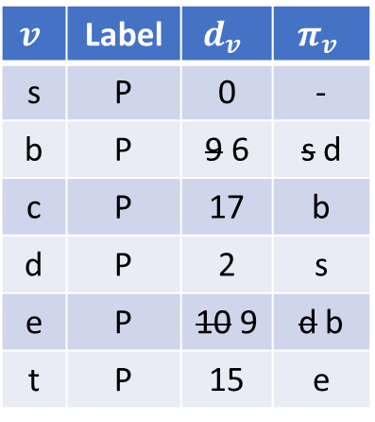
Example
$$v$$
Permanent
$$v$$
Temporary
d
b
6
17
11
17+12=29
$$v$$ | Label | $$d_{v}$$ | $$π_{v}$$
s | P | 0 | -
b | P | 9 6 | s d
c | P | 17 | b
d | P | 2 | s
e | P | 10 9 | d b
t | P | 15 | e
b
c
9
12
-
3
e
0
s
4
5
t
15
17+5=22
2
1
6
d
e
8
2
9
s
b
Update distances to reachable vertices which are labelled temporary. No changes

Slide 22
Example
$$v$$
Permanent
$$v$$
Temporary
d
b
6
17
11
$$v$$ | Label | $$d_{v}$$ | $$π_{v}$$
s | P | 0 | -
b | P | 9 6 | s d
c | P | 17 | b
d | P | 2 | s
e | P | 10 9 | d b
t | P | 15 | e
b
c
9
12
-
3
e
0
s
4
5
t
15
2
1
6
d
e
8
2
9
s
b
Final Network and Table

Slide 23
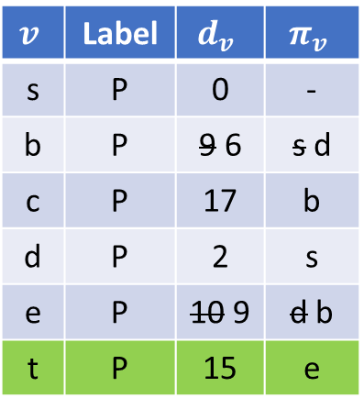
Example
$$v$$
Permanent
$$v$$
Temporary
d
b
6
17
11
$$v$$ | Label | $$d_{v}$$ | $$π_{v}$$
s | P | 0 | -
b | P | 9 6 | s d
c | P | 17 | b
d | P | 2 | s
e | P | 10 9 | d b
t | P | 15 | e
b
c
9
12
-
3
e
0
s
4
5
t
15
2
1
6
d
e
8
2
9
s
b
To compute the shortest path, work backwards from the source along the predecessor

Slide 24
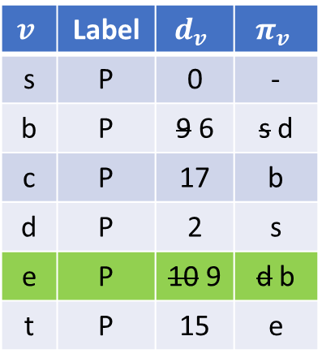
Example
$$v$$
Permanent
$$v$$
Temporary
d
b
6
17
11
$$v$$ | Label | $$d_{v}$$ | $$π_{v}$$
s | P | 0 | -
b | P | 9 6 | s d
c | P | 17 | b
d | P | 2 | s
e | P | 10 9 | d b
t | P | 15 | e
b
c
9
12
-
3
e
0
s
4
5
t
15
2
1
6
d
e
8
2
9
s
b
To compute the shortest path, work backwards from the source along the predecessor

Slide 25
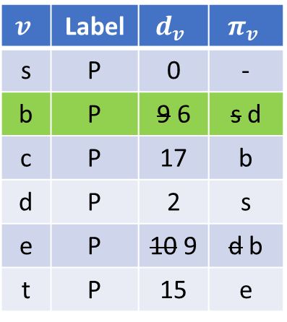
Example
$$v$$
Permanent
$$v$$
Temporary
d
b
6
17
11
$$v$$ | Label | $$d_{v}$$ | $$π_{v}$$
s | P | 0 | -
b | P | 9 6 | s d
c | P | 17 | b
d | P | 2 | s
e | P | 10 9 | d b
t | P | 15 | e
b
c
9
12
-
3
e
0
s
4
5
t
15
2
1
6
d
e
8
2
9
s
b
To compute the shortest path, work backwards from the source along the predecessor

Slide 26
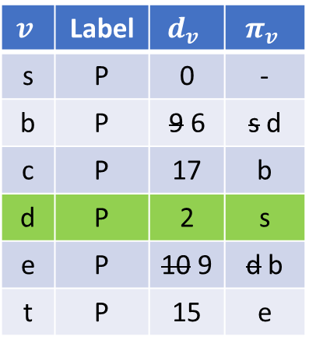
Example
$$v$$
Permanent
$$v$$
Temporary
d
b
6
17
11
$$v$$ | Label | $$d_{v}$$ | $$π_{v}$$
s | P | 0 | -
b | P | 9 6 | s d
c | P | 17 | b
d | P | 2 | s
e | P | 10 9 | d b
t | P | 15 | e
b
c
9
12
-
3
e
0
s
4
5
t
15
2
1
6
d
e
8
2
9
s
b
To compute the shortest path, work backwards from the source along the predecessor

Slide 27
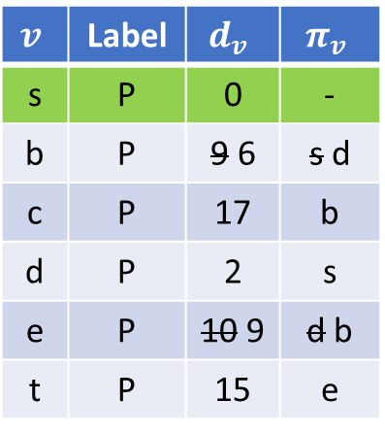
Example
$$v$$
Permanent
$$v$$
Temporary
d
b
6
17
11
$$v$$ | Label | $$d_{v}$$ | $$π_{v}$$
s | P | 0 | -
b | P | 9 6 | s d
c | P | 17 | b
d | P | 2 | s
e | P | 10 9 | d b
t | P | 15 | e
b
c
9
12
-
3
e
0
s
4
5
t
15
2
1
6
d
e
8
2
9
s
b
Shortest path from $s$ to $t$ is $s−d−b−e−t$ with a path length of $15$

Slide 28
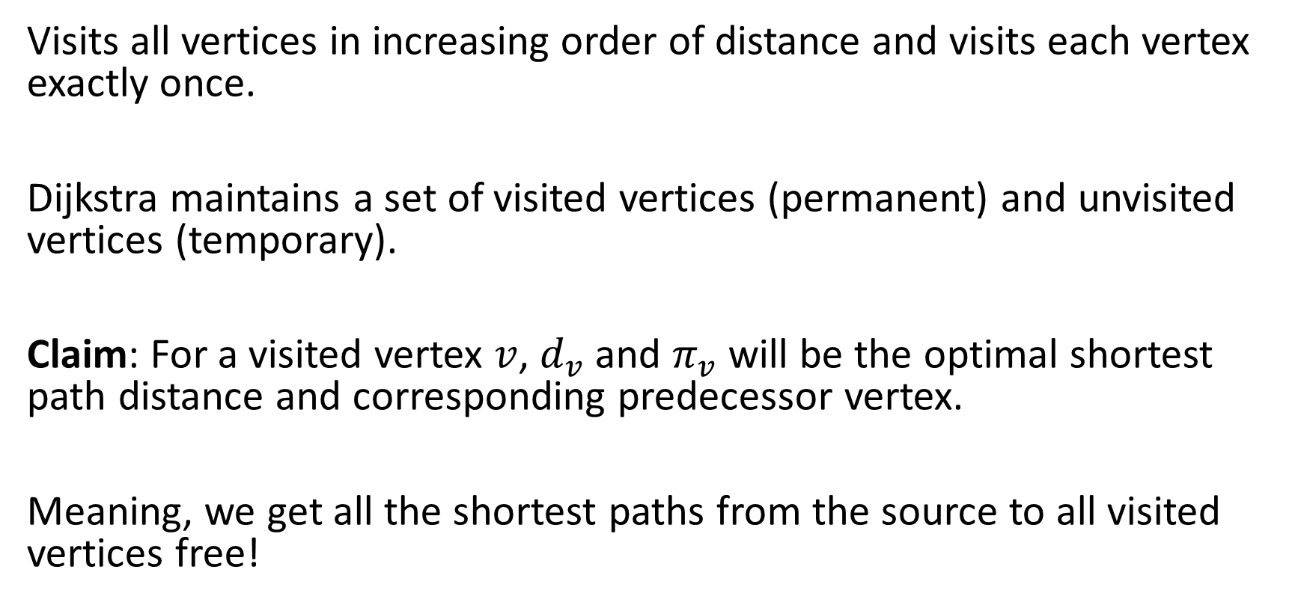
Correctness
Visits all vertices in increasing order of distance and visits each vertex exactly once.
Dijkstra maintains a set of visited vertices (permanent) and unvisited vertices (temporary).
Claim: For a visited vertex $v$, $d_{v}$ and $π_{v}$ will be the optimal shortest path distance and corresponding predecessor vertex.
Meaning, we get all the shortest paths from the source to all visited vertices free!

Slide 29
Shortest sub-path
$$v$$
Permanent
$$v$$
Temporary
d
b
6
17
11
$$v$$ | Label | $$d_{v}$$ | $$π_{v}$$
s | P | 0 | -
b | P | 9 6 | s d
c | P | 17 | b
d | P | 2 | s
e | P | 10 9 | d b
t | P | 15 | e
c
b
9
12
-
3
e
0
s
4
5
t
15
2
1
6
d
e
8
2
9
s
b
For example the shortest path from vertex $s$ to $b$ is $s−d−b$ of length 6

Slide 30
Example 2

Slide 31
Dijkstra Example 2
$$v$$
Permanent
$$v$$
Temporary
-
-
∞
∞
1
$$v$$ | Label | $$d_{v}$$ | $$π_{v}$$
s | T | 0 | -
b | T
c | T
d | T
e | T
t | T
b
c
9
1
-
3
-
0
s
4
5
t
∞
2
1
10
d
e
1
∞
∞
-
-
Initialise the network, source vertex has a distance of 0 and all other vertices a distance of $∞$

Slide 32
Example 2
$$v$$
Permanent
$$v$$
Temporary
-
-
∞
∞
1
$$v$$ | Label | $$d_{v}$$ | $$π_{v}$$
s | P | 0 | -
b | T
c | T
d | T
e | T
t | T
b
c
9
1
-
3
-
0
s
4
5
t
∞
2
1
10
d
e
1
∞
∞
-
-
Label temporary vertex with minimum distance as permanent

Slide 33
Example 2
$$v$$
Permanent
$$v$$
Temporary
s
-
9
∞
1
$$v$$ | Label | $$d_{v}$$ | $$π_{v}$$
s | P | 0 | -
b | T | 9 | s
c | T
d | T | 2 | s
e | T
t | T
0+9=9
b
c
9
1
-
3
-
0
s
4
5
t
∞
2
1
10
0+2=2
d
e
1
2
∞
s
-
Update distances to reachable vertices which are labelled temporary

Slide 34
Example 2
$$v$$
Permanent
$$v$$
Temporary
s
-
9
∞
1
$$v$$ | Label | $$d_{v}$$ | $$π_{v}$$
s | P | 0 | -
b | T | 9 | s
c | T
d | P | 2 | s
e | T
t | T
b
c
9
1
-
3
-
0
s
4
5
t
∞
2
1
10
d
e
1
2
∞
s
-
Label temporary vertex with minimum distance as permanent

Slide 35
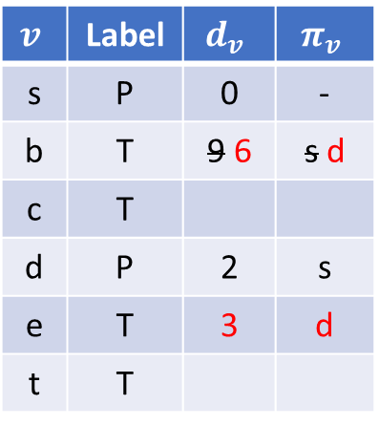
Example 2
$$v$$
Permanent
$$v$$
Temporary
d
-
6
∞
1
$$v$$ | Label | $$d_{v}$$ | $$π_{v}$$
s | P | 0 | -
b | T | 9 6 | s d
c | T
d | P | 2 | s
e | T | 3 | d
t | T
b
c
9
1
-
3
-
0
s
4
2+4=6
5
t
∞
2
1
10
d
e
1
2
3
2+1=3
s
d
Update distances to reachable vertices which are labelled temporary

Slide 36
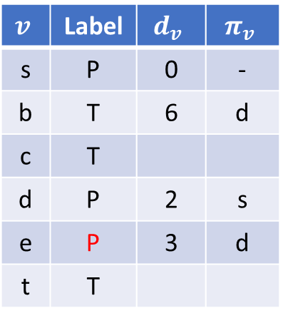
Example 2
$$v$$
Permanent
$$v$$
Temporary
d
-
6
∞
1
$$v$$ | Label | $$d_{v}$$ | $$π_{v}$$
s | P | 0 | -
b | T | 6 | d
c | T
d | P | 2 | s
e | P | 3 | d
t | T
b
c
9
1
-
3
-
0
s
4
5
t
∞
2
1
10
d
e
1
2
3
s
d
Label temporary vertex with minimum distance as permanent

Slide 37
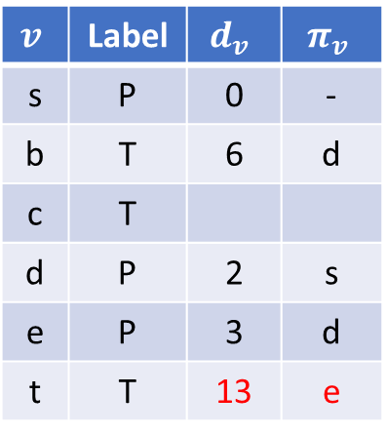
Example 2
$$v$$
Permanent
$$v$$
Temporary
d
-
6
∞
1
$$v$$ | Label | $$d_{v}$$ | $$π_{v}$$
s | P | 0 | -
b | T | 6 | d
c | T
d | P | 2 | s
e | P | 3 | d
t | T | 13 | e
b
c
9
1
-
3
e
0
s
4
5
t
13
2
1
10
d
e
3+10=13
1
2
3
s
d
Update distances to reachable vertices which are labelled temporary

Slide 38
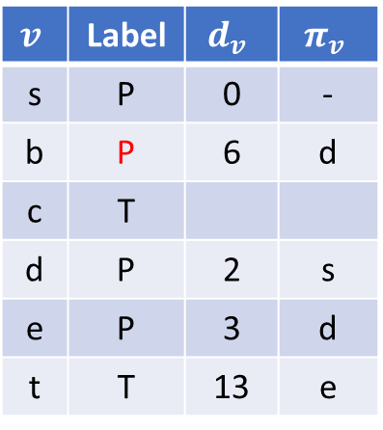
Example 2
$$v$$
Permanent
$$v$$
Temporary
d
-
6
∞
1
$$v$$ | Label | $$d_{v}$$ | $$π_{v}$$
s | P | 0 | -
b | P | 6 | d
c | T
d | P | 2 | s
e | P | 3 | d
t | T | 13 | e
b
c
9
1
-
3
e
0
s
4
5
t
13
2
1
10
d
e
1
2
3
s
d
Label temporary vertex with minimum distance as permanent

Slide 39
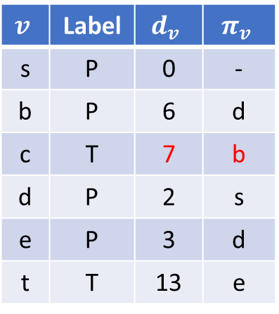
Example 2
$$v$$
Permanent
$$v$$
Temporary
d
b
6+1=7
6
7
1
$$v$$ | Label | $$d_{v}$$ | $$π_{v}$$
s | P | 0 | -
b | P | 6 | d
c | T | 7 | b
d | P | 2 | s
e | P | 3 | d
t | T | 13 | e
b
c
9
1
6+3=9
-
3
e
0
s
4
5
t
13
2
1
10
d
e
1
2
3
s
d
Update distances to reachable vertices which are labelled temporary

Slide 40
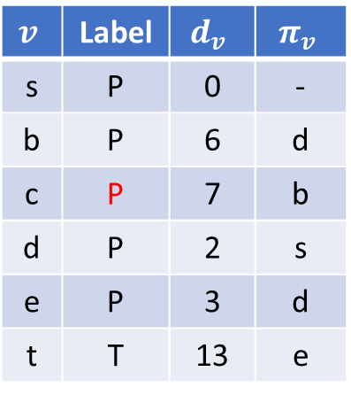
Example 2
$$v$$
Permanent
$$v$$
Temporary
d
b
6
7
1
$$v$$ | Label | $$d_{v}$$ | $$π_{v}$$
s | P | 0 | -
b | P | 6 | d
c | P | 7 | b
d | P | 2 | s
e | P | 3 | d
t | T | 13 | e
b
c
9
1
-
3
e
0
s
4
5
t
13
2
1
10
d
e
1
2
3
s
d
Label temporary vertex with minimum distance as permanent

Slide 41
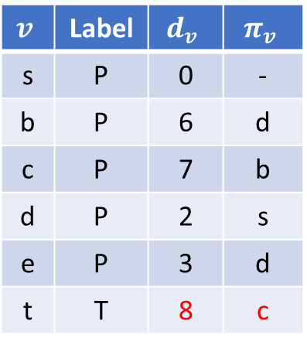
Example 2
$$v$$
Permanent
$$v$$
Temporary
d
b
6
7
1
$$v$$ | Label | $$d_{v}$$ | $$π_{v}$$
s | P | 0 | -
b | P | 6 | d
c | P | 7 | b
d | P | 2 | s
e | P | 3 | d
t | T | 8 | c
7+1=8
b
c
9
1
-
3
c
0
s
4
5
t
8
7+5=12
2
1
10
d
e
1
2
3
s
d
Update distances to reachable vertices which are labelled temporary

Slide 42
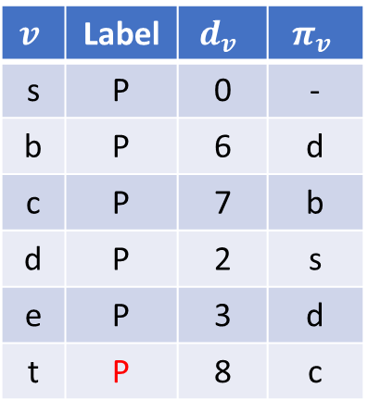
Example 2
$$v$$
Permanent
$$v$$
Temporary
d
b
6
7
1
$$v$$ | Label | $$d_{v}$$ | $$π_{v}$$
s | P | 0 | -
b | P | 6 | d
c | P | 7 | b
d | P | 2 | s
e | P | 3 | d
t | P | 8 | c
b
c
9
1
-
3
c
0
s
4
5
t
8
2
1
10
d
e
1
2
3
s
d
Label temporary vertex with minimum distance as permanent. All nodes reached. STOP

Slide 43
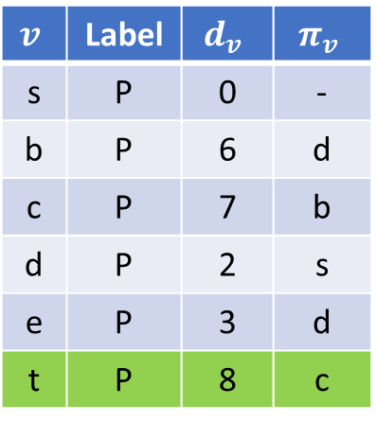
Example 2
$$v$$
Permanent
$$v$$
Temporary
d
b
6
7
1
$$v$$ | Label | $$d_{v}$$ | $$π_{v}$$
s | P | 0 | -
b | P | 6 | d
c | P | 7 | b
d | P | 2 | s
e | P | 3 | d
t | P | 8 | c
b
c
9
1
-
3
c
0
s
4
5
t
8
2
1
10
d
e
1
2
3
s
d
To compute the shortest path, work backwards from the source along the predecessor

Slide 44
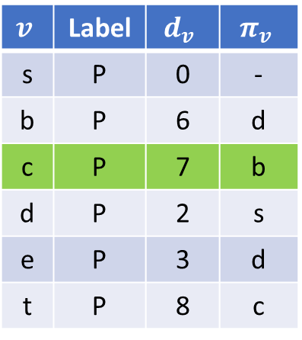
Example 2
$$v$$
Permanent
$$v$$
Temporary
d
b
6
7
1
$$v$$ | Label | $$d_{v}$$ | $$π_{v}$$
s | P | 0 | -
b | P | 6 | d
c | P | 7 | b
d | P | 2 | s
e | P | 3 | d
t | P | 8 | c
b
c
9
1
-
3
c
0
s
4
5
t
8
2
1
10
d
e
1
2
3
s
d
To compute the shortest path, work backwards from the source along the predecessor

Slide 45
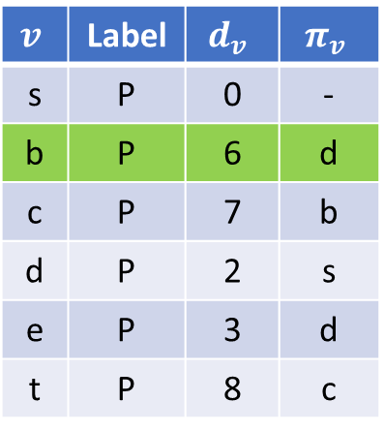
Example 2
$$v$$
Permanent
$$v$$
Temporary
d
b
6
7
1
$$v$$ | Label | $$d_{v}$$ | $$π_{v}$$
s | P | 0 | -
b | P | 6 | d
c | P | 7 | b
d | P | 2 | s
e | P | 3 | d
t | P | 8 | c
b
c
9
1
-
3
c
0
s
4
5
t
8
2
1
10
d
e
1
2
3
s
d
To compute the shortest path, work backwards from the source along the predecessor

Slide 46
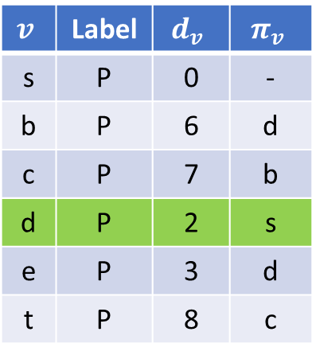
Example 2
$$v$$
Permanent
$$v$$
Temporary
d
b
6
7
1
$$v$$ | Label | $$d_{v}$$ | $$π_{v}$$
s | P | 0 | -
b | P | 6 | d
c | P | 7 | b
d | P | 2 | s
e | P | 3 | d
t | P | 8 | c
b
c
9
1
-
3
c
0
s
4
5
t
8
2
1
10
d
e
1
2
3
s
d
Shortest path from $s$ to $t$ is $s−d−b−c−t$ with a path length of $8$

Slide 47
Example 3
Optimisation
If we are interested in a given destination then…
If we reach the destination vertex and all temporary nodes have a higher value. We can stop!
This will be the optimal shortest path

Slide 48
Dijkstra Example 3
$$v$$
Permanent
$$v$$
Temporary
-
-
∞
∞
1
$$v$$ | Label | $$d_{v}$$ | $$π_{v}$$
s | T | 0 | -
b | T
c | T
d | T
e | T
t | T
b
c
9
1
-
3
-
0
s
10
5
t
∞
2
1
1
d
e
1
∞
∞
-
-
Initialise the network, source vertex has a distance of 0 and all other vertices a distance of $∞$

Slide 49
Example 3
$$v$$
Permanent
$$v$$
Temporary
-
-
∞
∞
1
$$v$$ | Label | $$d_{v}$$ | $$π_{v}$$
s | P | 0 | -
b | T
c | T
d | T
e | T
t | T
b
c
9
1
-
3
-
0
s
10
5
t
∞
2
1
1
d
e
1
∞
∞
-
-
Label temporary vertex with minimum distance as permanent

Slide 50
Example 3
$$v$$
Permanent
$$v$$
Temporary
s
-
9
∞
1
$$v$$ | Label | $$d_{v}$$ | $$π_{v}$$
s | P | 0 | -
b | T | 9 | s
c | T
d | T | 2 | s
e | T
t | T
0+9=9
b
c
9
1
-
3
-
0
s
10
5
t
∞
2
1
1
0+2=2
d
e
1
2
∞
s
-
Update distances to reachable vertices which are labelled temporary

Slide 51
Example 3
$$v$$
Permanent
$$v$$
Temporary
s
-
9
∞
1
$$v$$ | Label | $$d_{v}$$ | $$π_{v}$$
s | P | 0 | -
b | T | 9 | s
c | T
d | P | 2 | s
e | T
t | T
b
c
9
1
-
3
-
0
s
10
5
t
∞
2
1
1
d
e
1
2
∞
s
-
Label temporary vertex with minimum distance as permanent

Slide 52
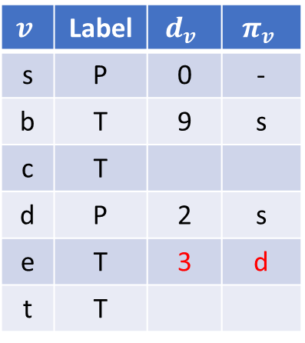
Example 3
$$v$$
Permanent
$$v$$
Temporary
s
-
9
∞
1
$$v$$ | Label | $$d_{v}$$ | $$π_{v}$$
s | P | 0 | -
b | T | 9 | s
c | T
d | P | 2 | s
e | T | 3 | d
t | T
b
c
9
1
-
3
-
0
s
10
5
t
∞
2+10=12
2
1
1
d
e
1
2
3
2+1=3
s
d
Update distances to reachable vertices which are labelled temporary

Slide 53

Example 3
$$v$$
Permanent
$$v$$
Temporary
s
-
9
∞
1
$$v$$ | Label | $$d_{v}$$ | $$π_{v}$$
s | P | 0 | -
b | T | 9 | s
c | T
d | P | 2 | s
e | P | 3 | d
t | T
b
c
9
1
-
3
-
0
s
10
5
t
∞
2
1
1
d
e
1
2
3
s
d
Label temporary vertex with minimum distance as permanent

Slide 54
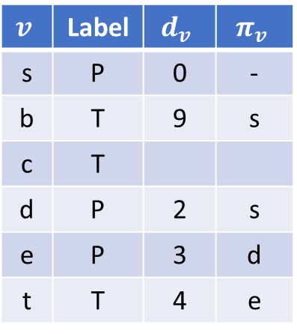
Example 3
$$v$$
Permanent
$$v$$
Temporary
s
-
9
∞
1
$$v$$ | Label | $$d_{v}$$ | $$π_{v}$$
s | P | 0 | -
b | T | 9 | s
c | T
d | P | 2 | s
e | P | 3 | d
t | T | 4 | e
b
c
9
1
-
3
e
0
s
10
5
t
4
2
1
1
d
e
1
2
3
s
d
Label temporary vertex with minimum distance as permanent

Slide 55
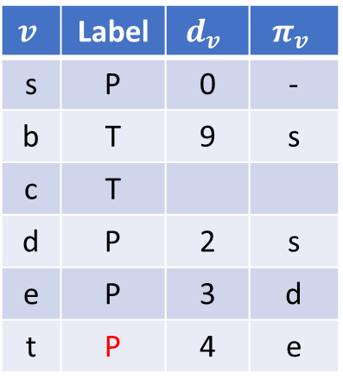
Example 3
$$v$$
Permanent
$$v$$
Temporary
s
-
9
∞
1
$$v$$ | Label | $$d_{v}$$ | $$π_{v}$$
s | P | 0 | -
b | T | 9 | s
c | T
d | P | 2 | s
e | P | 3 | d
t | P | 4 | e
b
c
9
1
-
3
e
0
s
10
5
t
4
2
1
1
d
e
1
2
3
s
d
We have reached the destination and all temporary nodes have a higher distance
STOP

Slide 56
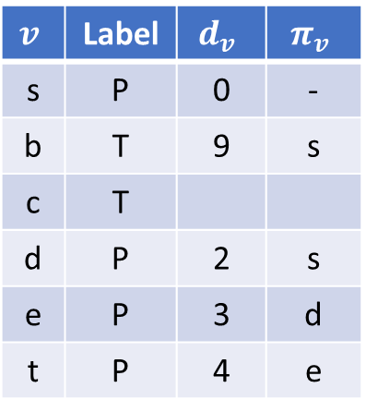
Example 3
$$v$$
Permanent
$$v$$
Temporary
s
-
9
∞
1
$$v$$ | Label | $$d_{v}$$ | $$π_{v}$$
s | P | 0 | -
b | T | 9 | s
c | T
d | P | 2 | s
e | P | 3 | d
t | P | 4 | e
b
c
9
1
-
3
e
0
s
10
5
t
4
2
1
1
d
e
1
2
3
s
d
This is the optimal path

Slide 57
References
Cormen, T. H., Leiserson, C. E., Rivest, R. L., Stein, C. (2001). Introduction to Algorithms. The MIT Press. ISBN: 0262032937
Taha, Hamdy. A - Operations Research: An Introduction (Tenth Edition)

